Slide 1

Text Processing Techniques
Women in AI Academy and Consultancy
Nabanita Roy

Slide 2
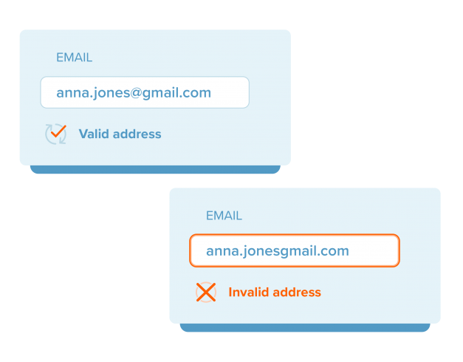
Text Extraction
Regular Expression or Regex
Checks whether a pattern exists
in each string or not
Email Regex Pattern:
>> pattern = r'\b[A-Za-z0-9._%+-]+@[A-Za-z0-9.-]+\.[A-Z|a-z]{2,}\b’
>> email = 'anna.jones@gmail.com'
>> import re # Python Library used for regex operations
>> re.fullmatch(pattern, email)

Slide 3
Text Wrangling
Tokenization
Tokenization is the process of converting a sentence into smaller units called tokens. A token is not necessarily a meaningful word from the dictionary.
tokens
Tokenized version :
‘Tokenization’, ‘is’, ‘the’, ‘process’, ‘of’, ‘converting’, ‘a’, ‘sentence’, ‘into’, ‘smaller’, ‘units’, ‘called’, ‘tokens’, ‘.’
sequence of tokens
Case Conversion
‘tokenization’, ‘is’, ‘the’, ‘process’, ‘of’, ‘converting’, ‘a’, ‘sentence’, ‘into’, ‘smaller’, ‘units’, ‘called’, ‘tokens’, ‘.’

Slide 4
Text Wrangling
What else can you spot?
Noise Removal
HTML Tags
Accented Characters
Symbols and Emojis
<p> I’ll see you soon ☺ <3, mon chéri <p>
Tokenized and Cleaned version:
‘I’ll’, ‘see’, ‘you’, ‘soon’, ‘mon’, ‘cherie’
Contractions
Language Translation
Information Loss – Emojis
Contraction Expansion
‘I’, ‘will’, ‘see’, ‘you’, ‘soon’, ‘mon’, ‘cherie’
Examples:
I’ll -> I will
We’ve -> We have
It’s -> It is

Slide 5
Text Wrangling
STOPWORDS REMOVAL
Stopwords are a set of commonly used words in any language.
Examples: a , an, the, is, was, are
These words are removed since they contain very little or no information.
Could be contextual, therefore, you can modify the standard list.

Slide 6
Text Wrangling
NORMALIZATION
Text normalization is the technique which transforms a word into its root or basic form in order to standardize text representation.
STEMMING LEMMATIZATION
refers to a crude heuristic process that chops off the ends of words
Examples:
important -> import
bravery -> braveri
process of deriving lemmas which involves understanding the semantics, morphology and the parts-of-speech(POS) the word belongs to
Examples:
important -> important
bravery -> bravery
Imported -> import

Slide 7
Text Tagging
POS Tagging
Synonyms: Grammatical Tagging | Word-Category Disambiguation
Part-of-speech tags describe the characteristic structure of lexical terms within a sentence; therefore, we can use them for making assumptions about semantics.
Example:
She [Pronoun] is[Verb] dancing[Verb] gracefully[Adjective].

Slide 8
Text Tagging
Named Entity Recognition
Identify specific entities mentioned in a text.
Example:
Dublin, 8th Sept: An NLP Workshop was conducted by Nabanita Roy.
Location Date Person

Slide 9
Thank You Q/A

